Slide 1


CSCI 5541: Natural Language Processing
Lecture 2: Introduction to NLP
James Mooney

Slide 2
Recitation and In-class Tutorials (next week) Announcement to Come Tomorrow via Slack
Computing basics
Setting up environment for PyTorch and Transformers
Pytorch Basics Tutorial
Tutorial on SciKit-learn/PyTorch
Tutorial on HuggingFace/vLLM

Slide 3
Announcement
If you miss the first class, please check out the course details in the lecture slides
Share your interests and project ideas in #random channel and actively look for your teammates. Team formation is due on Feb 6.
If you are enrolled but not invited to Slack, please send James an email.
HW1 out tomorrow (Due: Feb 4)
OH out tomorrow on course website

Slide 4
Outline
What is NLP?
Does ChatGPT solve every NLP problem?
Language consists of many levels of structure
What makes language so difficult to process?
How to process language?
Recent Developments (2019-2024)
Limits of LLMs and the Financial Incentives of GenAI

Slide 5
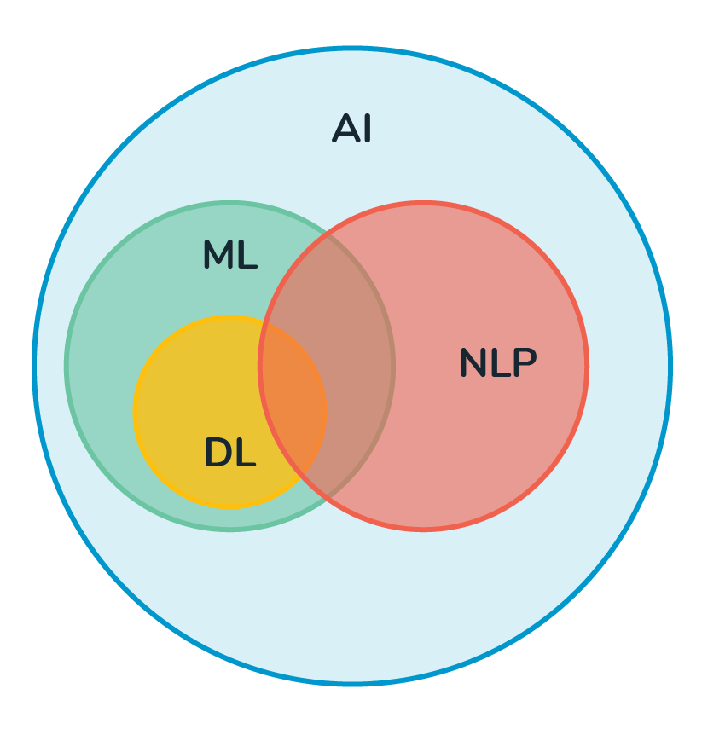
NLP is interdisciplinary
Linguistics
Artificial Intelligence
Machine Learning (2000-present)
Recently,
Social Science and Humanities
Human-computer Interaction
Education
Robotics
Cognitive Science / Brain Science / Neuroscience
Psychology
Law / Medical / Biology
..
Notes:
AI: reasoning, comprehension, perception, social cognition, geometry,
Linguistics: language (image BC 2000, etc; no language; but only signed language for communication) (language is artificial and developed by humans, not human’s nature ability)
Humans are social animals. Language is used for social communication.
NLP systems are developed; how do we interact with them?
think of sociolinguistics, historical linguistics, psycholinguistics, and neurolinguistics.

Slide 6
NLP vs (Computational) Linguistics
Linguistics involve the nature of linguistic representations and linguistic knowledge, and how linguistic knowledge is acquired and deployed in comprehension of language.
Computational linguistics asks what humans are computing and how, by mathematically defining classes of linguistic representations and formal grammars to capture the range of phenomena in human languages.
NLP is the art of solving engineering problems that need to analyze (or generate) natural language text. The metric is whether you got good solutions on the engineering problem. After all, their goal is not a full theory but rather the simplest, most efficient approach that will get the job done.

Slide 7
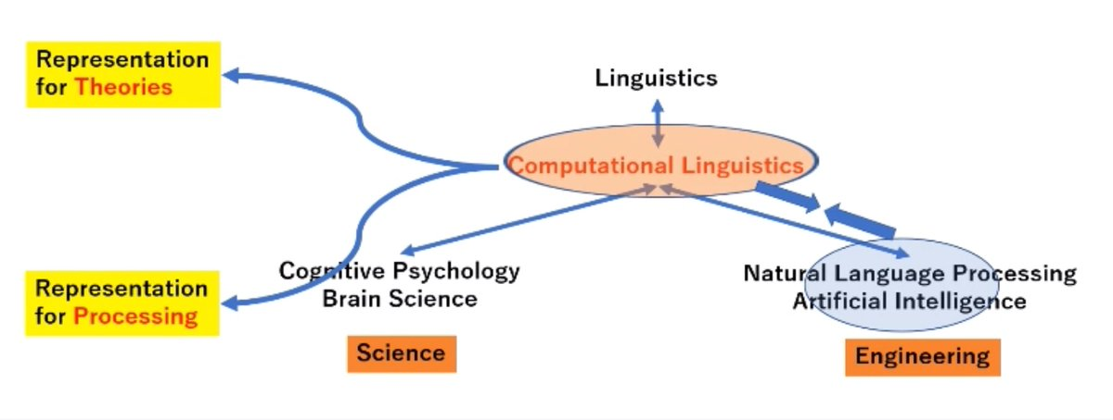
https://twitter.com/radamihalcea/status/1422892875218628616

Slide 8
Linguistic Theories
Notes:
Processing is such a vague term:

Slide 9
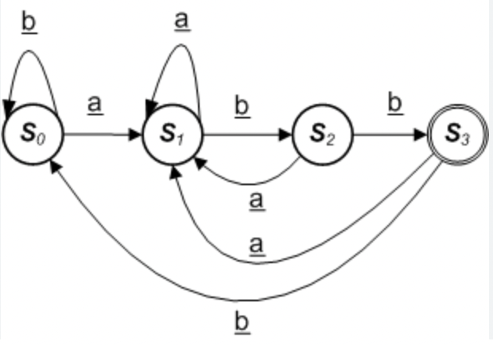
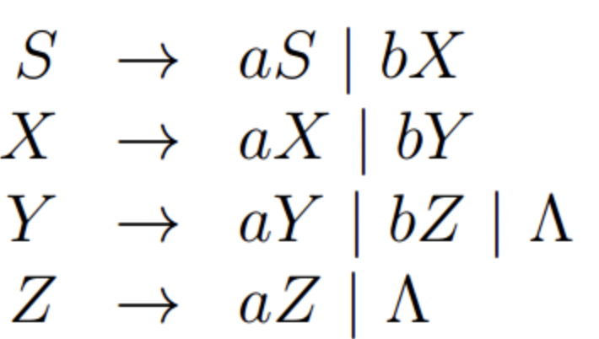
Language as Formal Logic

Slide 10
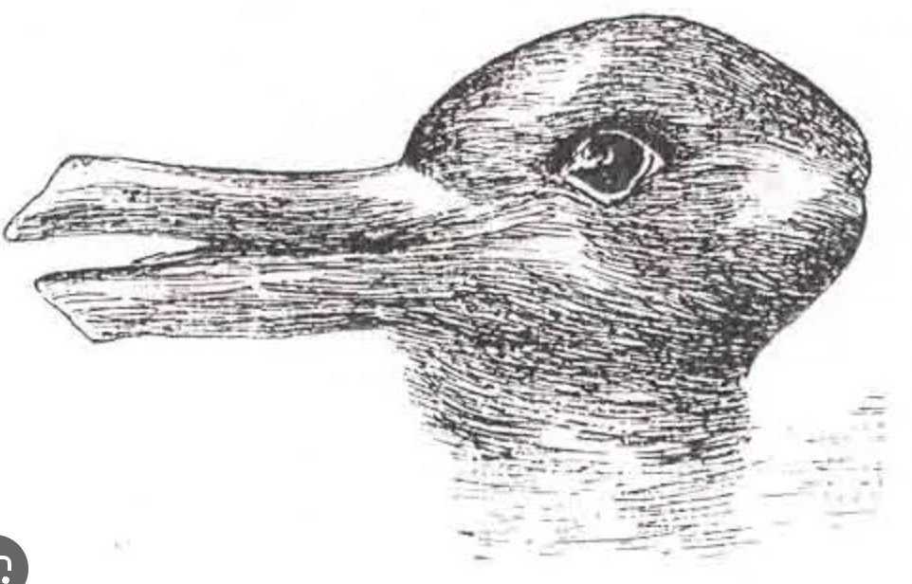
Language as Social Activity

Slide 11
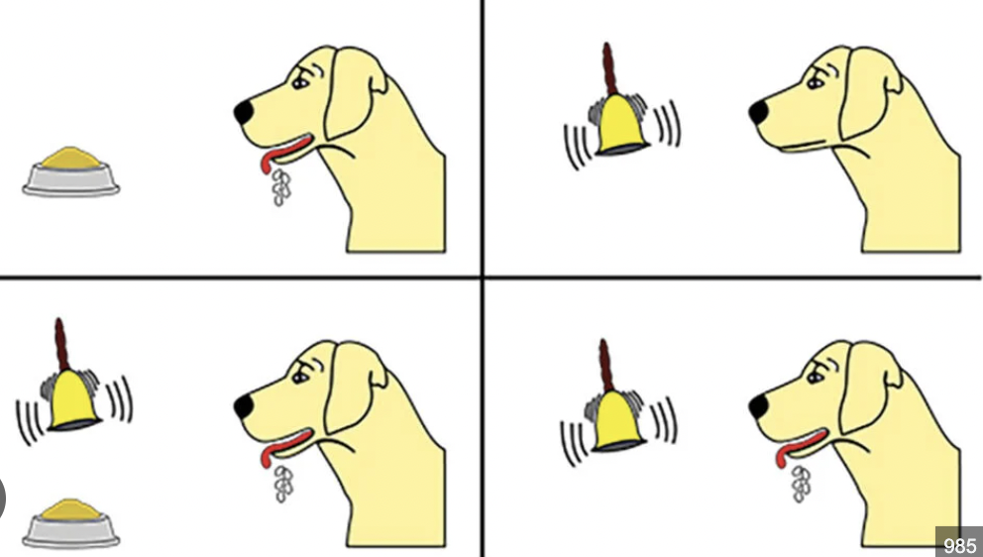

How biased are our mental models to Language?
Behaviorist – Little Bias within models
Language is Embedded in our minds – High bias

Slide 12
NLP
= Processing language with computers
Notes:
Processing is such a vague term:

Slide 13
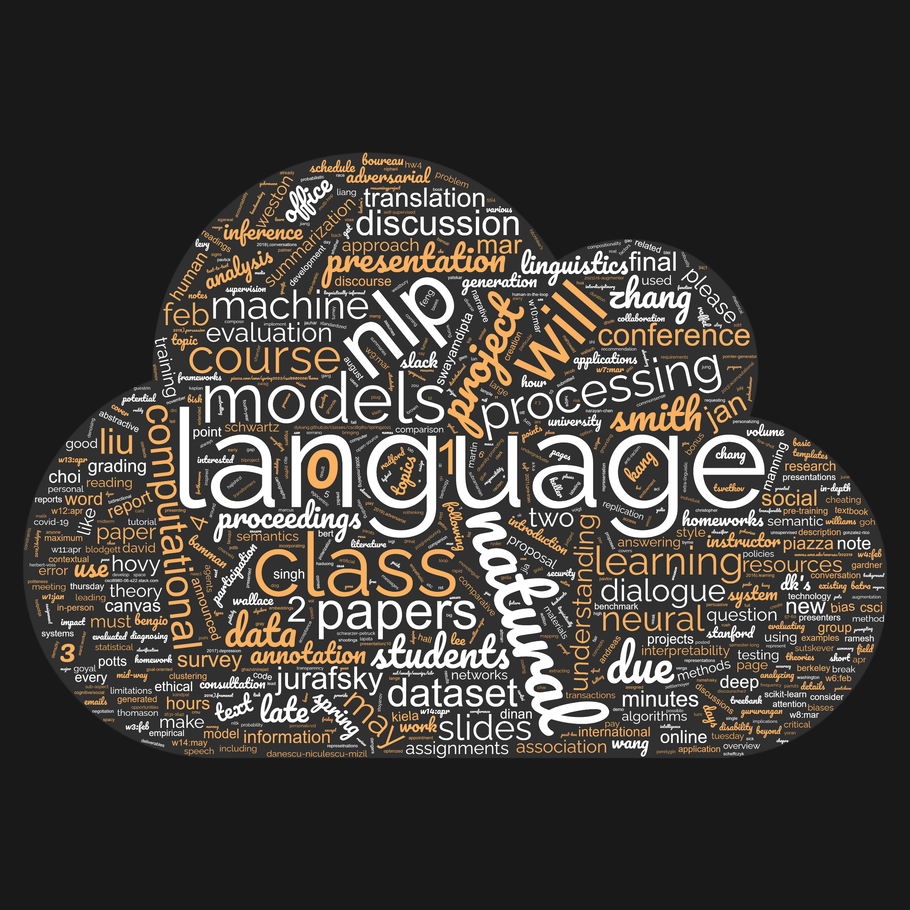
Processing as sorting and clouding
Word cloud generated with text on our class homepage using www.wordclouds.com

Slide 14
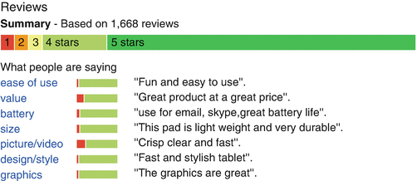
Processing as understanding sentiment
Lei Zhang and Bing Liu, Sentiment Analysis and Opinion Mining

Slide 15
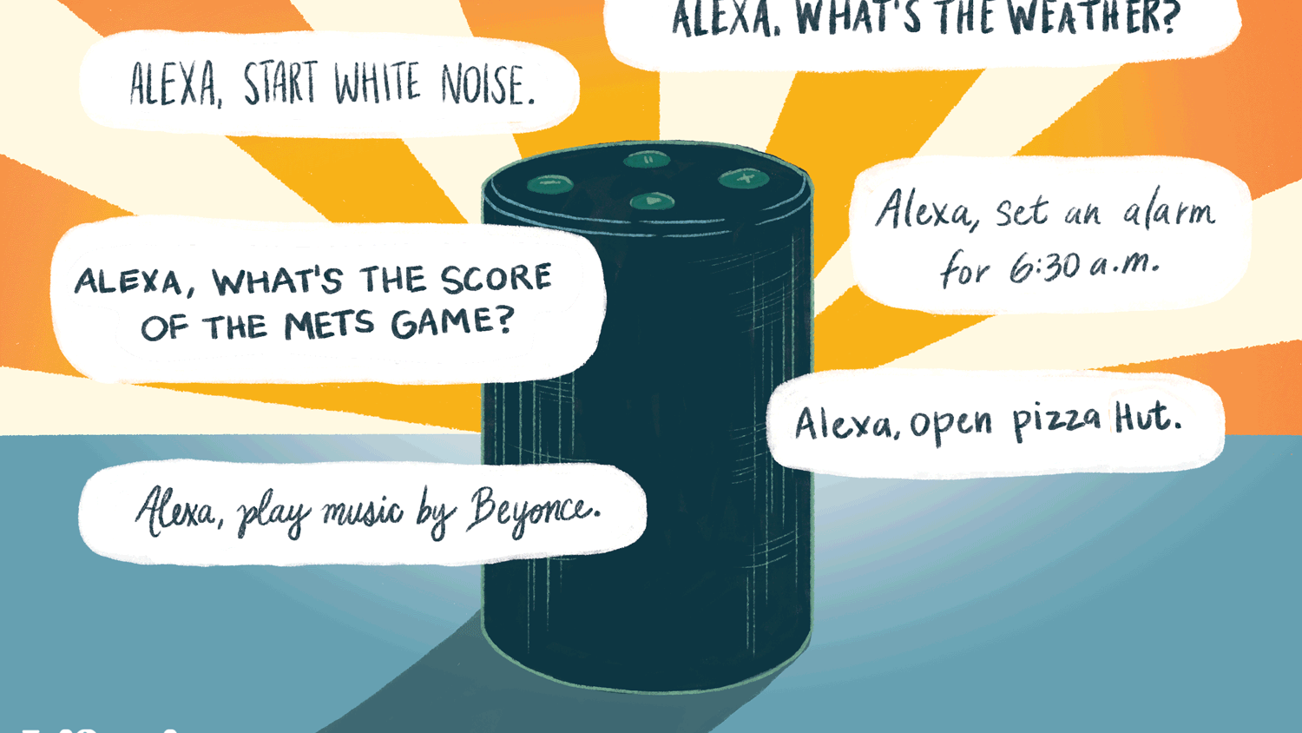
Processing as assistant

Slide 16
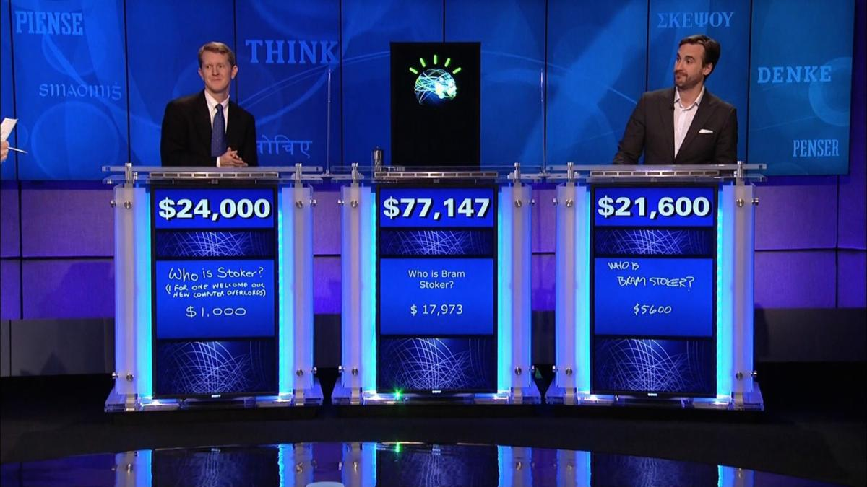
Processing as question answering
What year was Abraham Lincoln born?
How many states were in the United States that year?
How much Chinese silk was exported to England in the end of the 18th century?
It’s alive: IBM’s Watson supercomputer defeats humans in final Jeopardy match, 2011

Slide 17
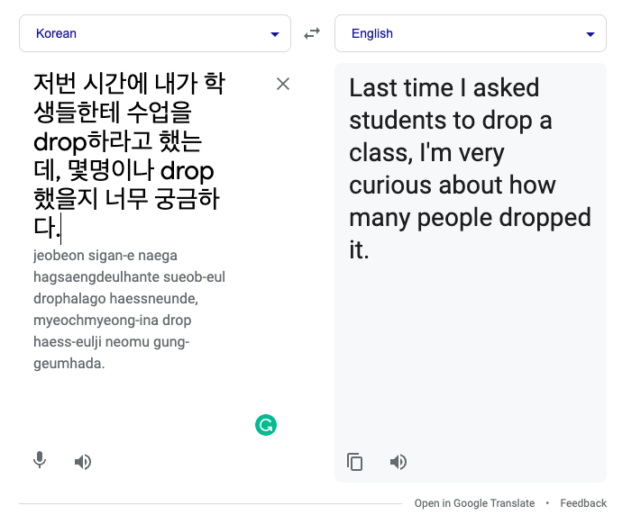
Processing as translation

Slide 18
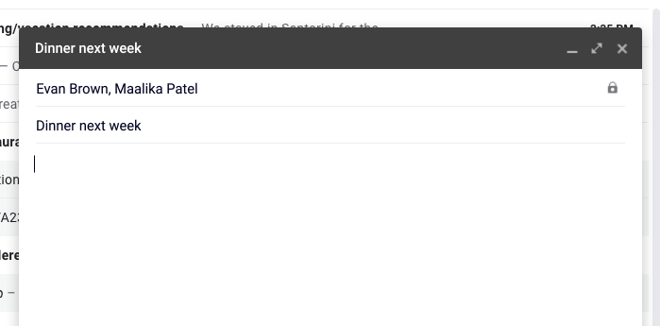
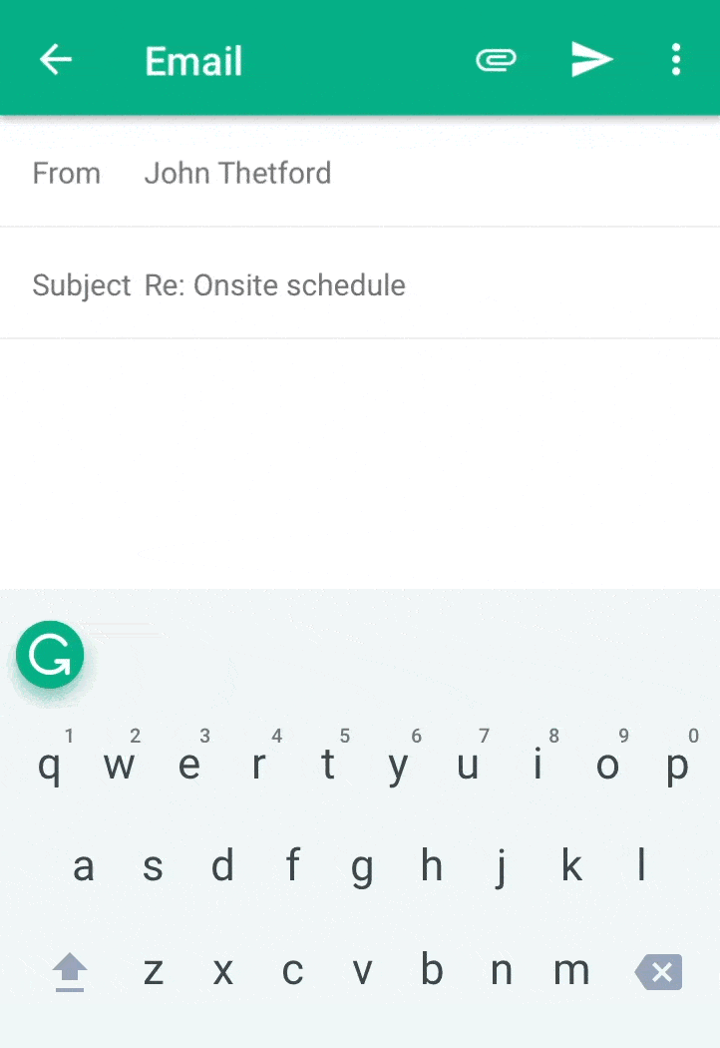
Processing as (email) assistant

Slide 19
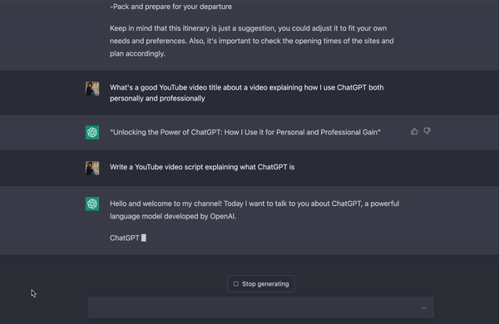
Processing as communication

Slide 20
Social cognition / Reasoning
“Two children, Chloe and Alexander, went for a walk. They both saw a dog and a tree. Alexander also saw a cat and pointed it out to Chloe. She went to pet the cat.”
“Did Chloe see the cat?”
Cause and effect
“You need flour to bake bread. You have a sack of flour in the garage. When you get there, you find that it got thoroughly soaked in a heavy rain last night.
So you have to ___”
Tracking long narratives
“Never in his life has Bashan caught a hare, nor will he ever; the thing is as good as impossible. Many dogs, they say, are the death of a hare, a single dog cannot achieve it, even one much speedier and more enduring than Bashan. The hare can ``double'' and Bashan cannot --- and that is all there is to it. How Bashan runs! It is beautiful to see a creature expending the utmost of its powers. He runs better than the hare does, he has stronger muscles, the distance between them visibly diminishes before I lose sight of them. And I make haste too, leaving the path and cutting across the park towards the river-bank, reaching the gravelled street in time to see the chase come raging on— the hopeful, thrilling chase, with Bashan on the hare’s very heels; — “One more push, Bashan!” I think, and feel like shouting;
“…..
Failure cases by GPT3, Gary Marcus & Ernst Davis

Slide 21
Do LLM’s solve every NLP problem?
Notes:
Processing is such a vague term:

Slide 22
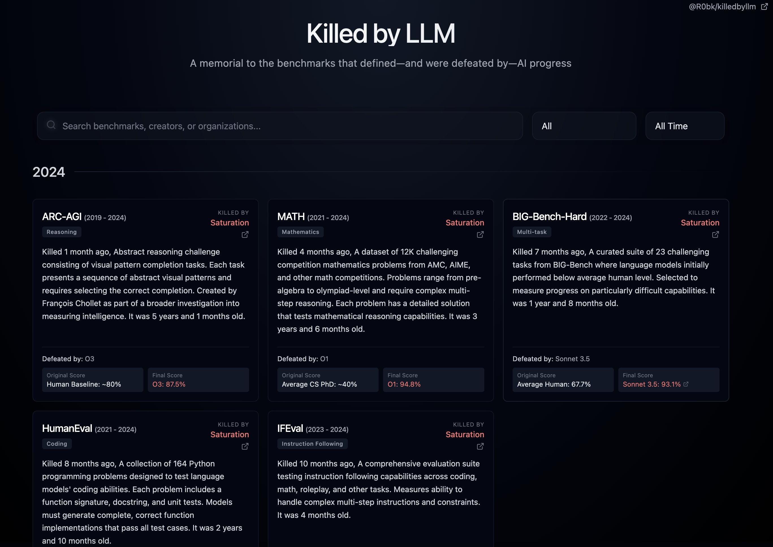
LLMs Keep Conquering New Benchmarks

Slide 23
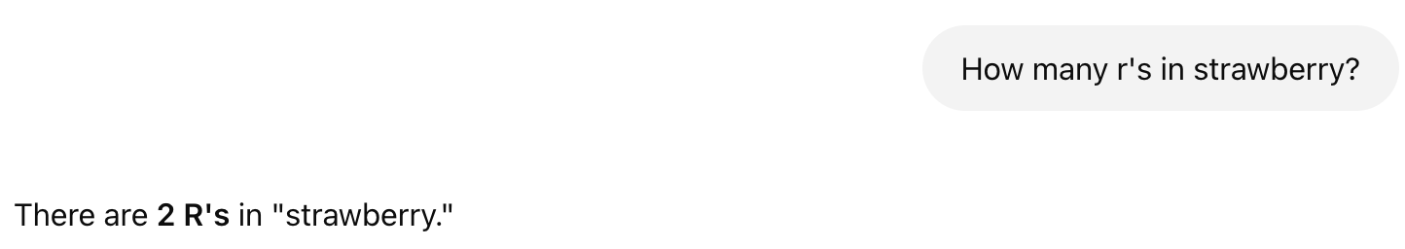

Slide 24


Slide 25
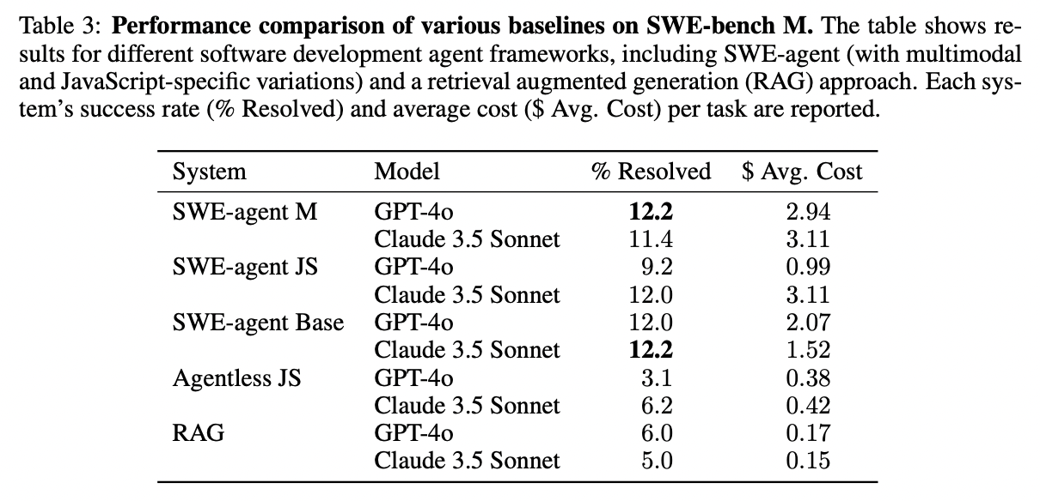

Slide 26
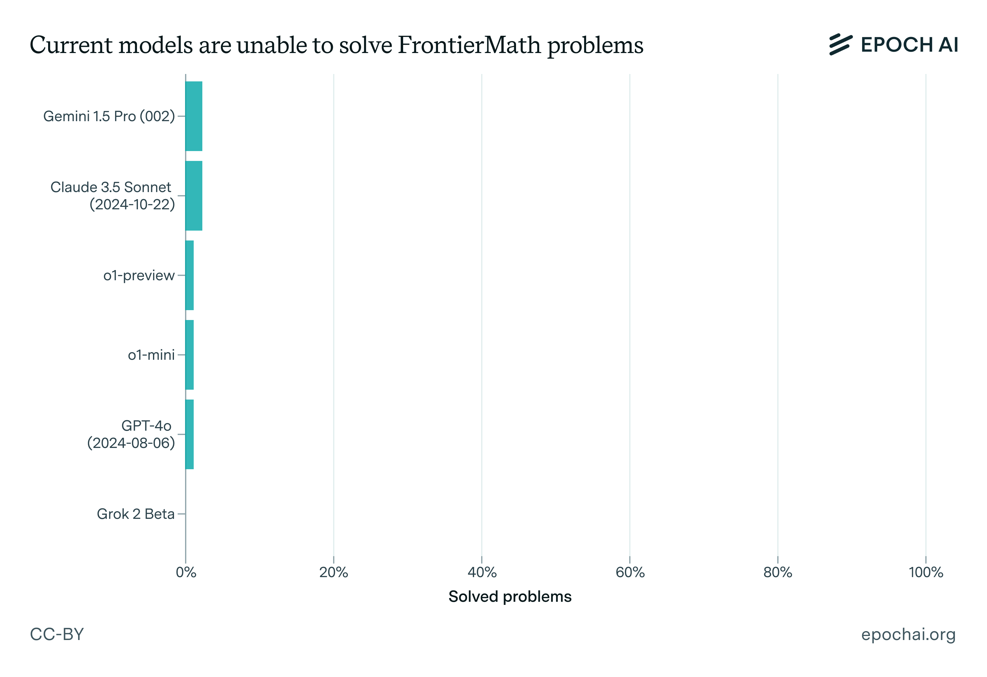
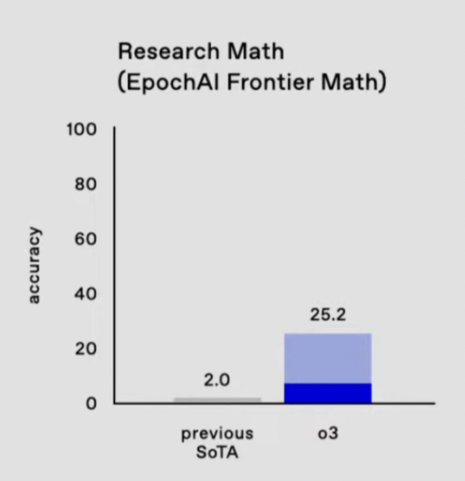

Slide 27
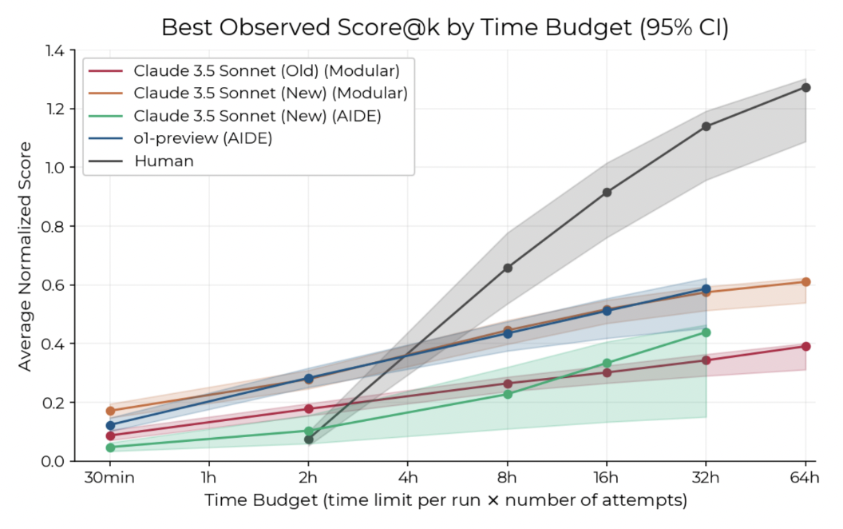

Slide 28
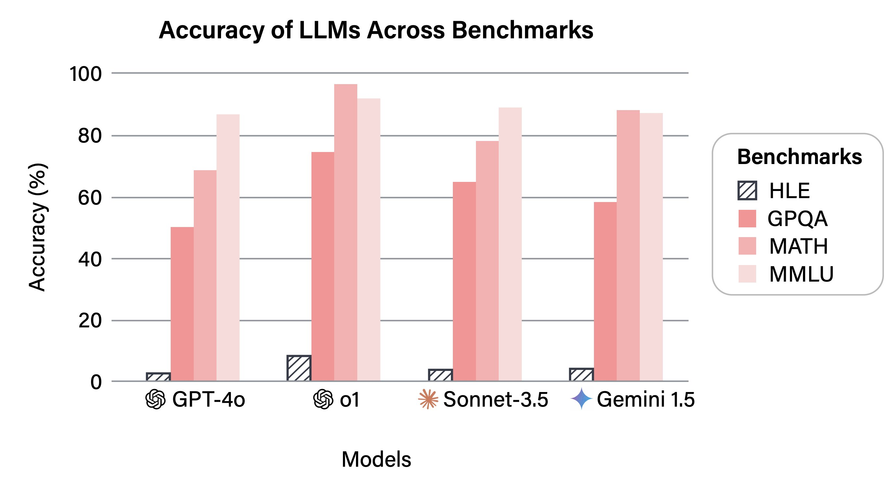
https://agi.safe.ai/

Slide 29
What makes language so difficult to process?
Notes:
Processing is such a vague term:

Slide 30
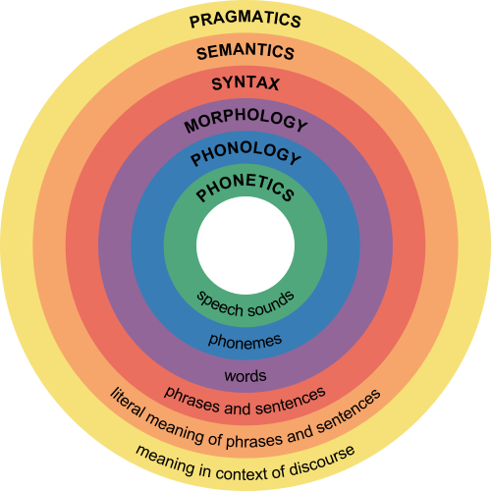
Language consists of many levels of structure
Humans fluently integrate all of these in generating and understanding language
Notes:
Humans fluently integrate all of these in producing/understanding language
Phonology: rules of speech sounds; how phonemes are used
Morphology: rules of word structure, how words/mo
Synatx: rules of sentence structures
Semantics: rules related to meaning of language
Prgramaitics: rules that occur within social situations.
Phonetics is the study of the production and perception of speech sounds, and phonology concerns the study of more complex and abstract sound patterns and structures (syllables, intonation, etc.).

Slide 31
This is a simple sentence

Slide 32
Phonology
Pronunciation modeling
Example by Nathan Schneider

Slide 33

Words
Tokenization
Language modeling
Spelling correction
Example by Nathan Schneider

Slide 34
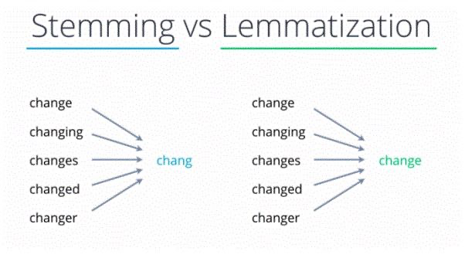
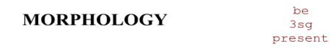
Morphology
Morphological analysis
Tokenization
Stemming / Lemmatization
Read more about stemming and lemmatization
https://nlp.stanford.edu/IR-book/html/htmledition/stemming-and-lemmatization-1.html
Example by Nathan Schneider
Notes:
3SG 3rd person singular subject marker.
The goal of both stemming and lemmatization is to reduce inflectional forms and sometimes derivationally related forms of a word to a common base form. For instance:
Stemming usually refers to a crude heuristic process that chops off the ends of words in the hope of achieving this goal correctly most of the time, and often includes the removal of derivational affixes. Lemmatization usually refers to doing things properly with the use of a vocabulary and morphological analysis of words, normally aiming to remove inflectional endings only and to return the base or dictionary form of a word, which is known as the lemma

Slide 35
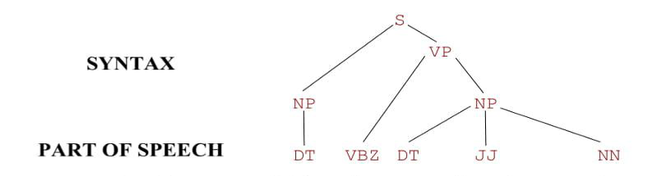
Parts of Speech (POS)
Part-of-speech tagging
Example by Nathan Schneider

Slide 36
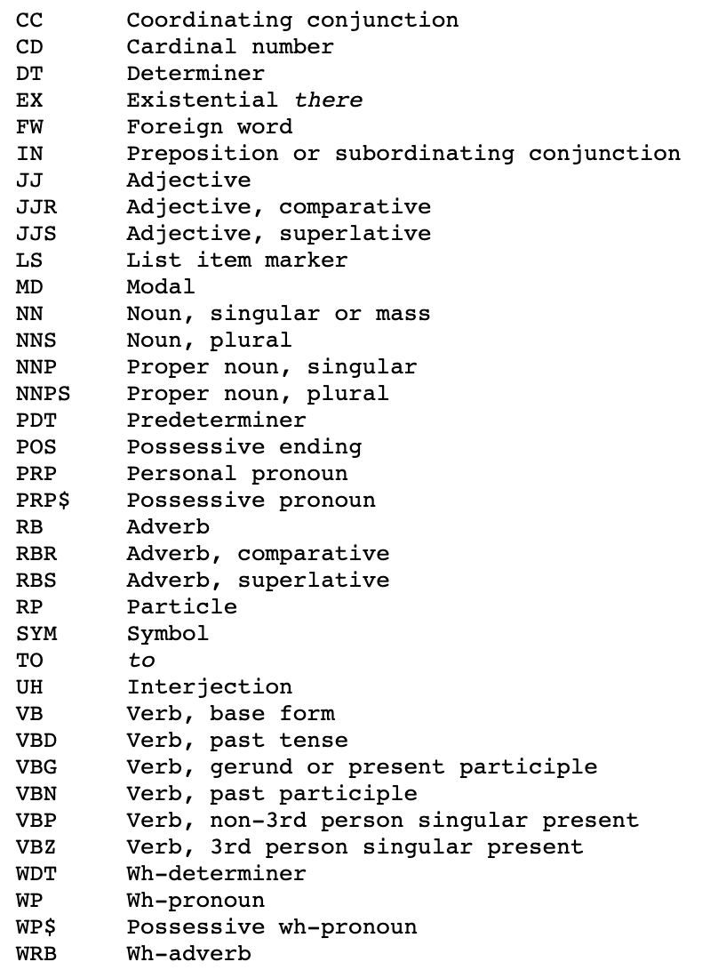
Parts of Speech (POS)
Part-of-speech tagging
Example by Nathan Schneider

Slide 37
Syntax
Syntax parsing
Example by Nathan Schneider

Slide 38
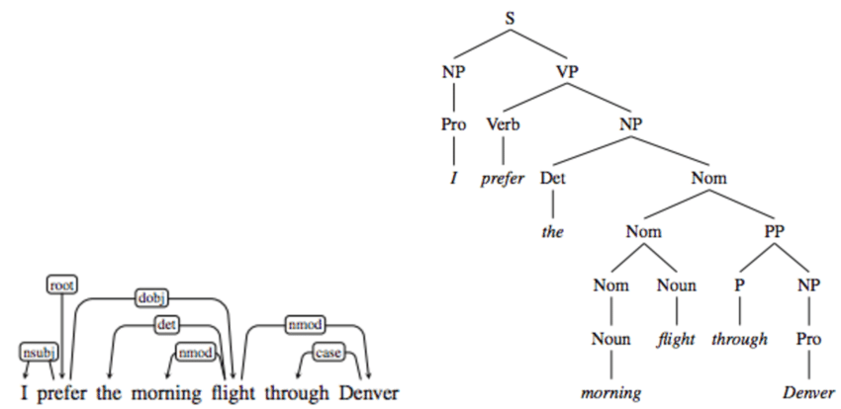
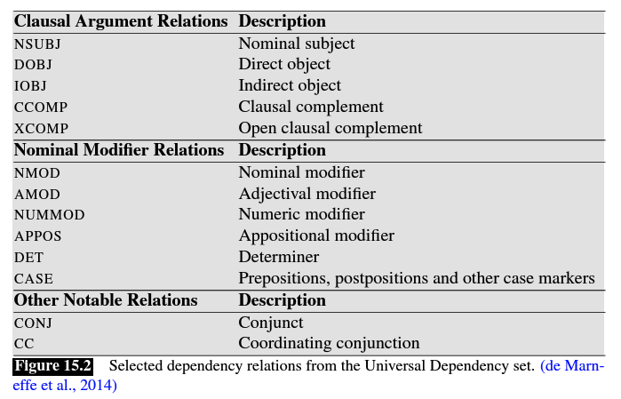
Syntax
Syntax parsing
Constituency Parsing: break a sentence into sub-phrases
Dependency Parsing: explore the dependencies between the words in a sentence
Example by Nathan Schneider

Slide 39
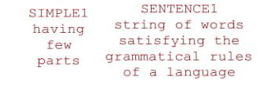

Semantics
Named entity recognition
Word sense disambiguation
Semantic role labeling
Frame semantics
Example by Nathan Schneider

Slide 40
Discourse (Pragmatics)
Co-reference resolution
CONTRAST
Example by Nathan Schneider

Slide 41
Language consists of many levels of structure
Humans fluently integrate all of these in generating and understanding language
Notes:
Humans fluently integrate all of these in producing/understanding language
Phonology: rules of speech sounds; how phonemes are used
Morphology: rules of word structure, how words/mo
Synatx: rules of sentence structures
Semantics: rules related to meaning of language
Prgramaitics: rules that occur within social situations.
Phonetics is the study of the production and perception of speech sounds, and phonology concerns the study of more complex and abstract sound patterns and structures (syllables, intonation, etc.).

Slide 42
What makes language difficult?
Language is ambiguous
Language needs to be scaled
Language is sparse
Language is varying
Language is implicit
Language is hard to represent

Slide 43
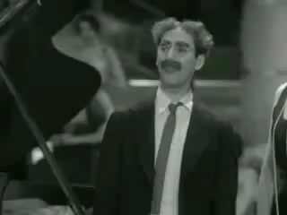
Ambiguity at multiple levels
“One morning I shot an elephant in my pajamas”
Groucho Marx
Notes:
Many jokes hinge on this idea: make a statement that the audience will naturally and logically interpret one way, and then indicate that you meant the words in a different way, that is perfectly valid grammatically, but unlikely or unexpected.
Put another (stiffer) way, all humor hinges on confusion of meta-levels

Slide 44




Ambiguity at multiple levels
“One morning I shot an elephant in my pajamas”
Notes:
Noun / verbs /

Slide 45
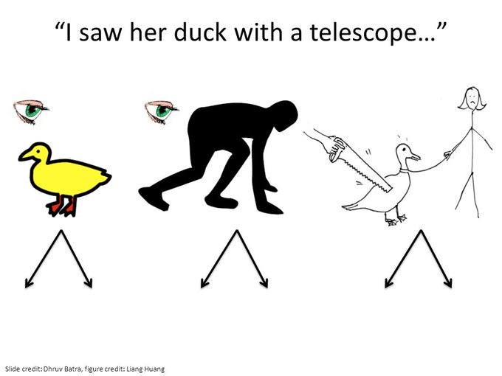
“I saw her duck with a telescope”
I used a telescope to observe a small web-footed broad-billed swimming bird belonging to a female person.
I observed a small web-footed broad-billed swimming bird belonging to a female person. The bird had a telescope.
I observed a female person move quickly downwards. The person had a telescope.
I used a telescope to observe a female person move quickly downwards.
I used a telescope to cut a small web-footed broad-billed swimming bird belonging to a female person.
I used a telescope to observe heavy cotton fabric of plain weave belonging to a female person.
I used a telescope to cut heavy cotton fabric of plain weave belonging to a female person.
Slide from Dhruv Batra and figure from Liang Huang
Notes:
The sentence is grammatically correct and semantically ambiguous

Slide 46
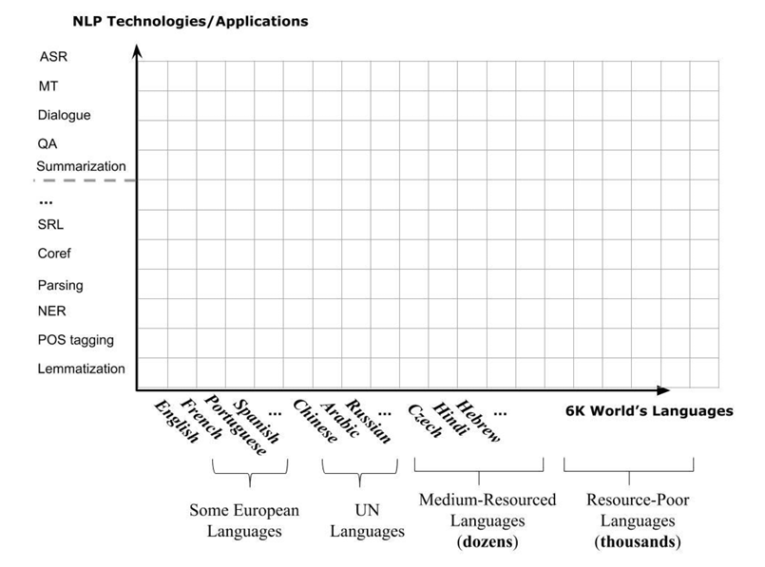
Scale: Applications x Languages

Slide 47
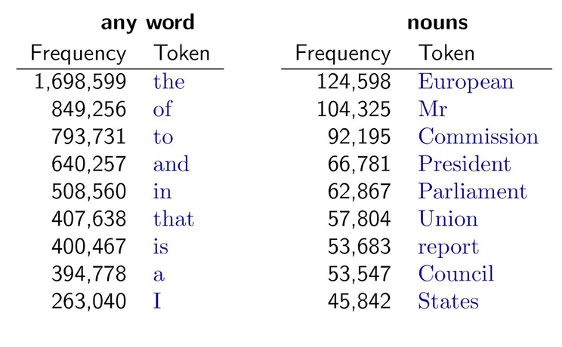
Sparsity
Sparse data due to Zipf’s Law
Most frequent words in the English Europarl corpus (out of 24M word tokens)
36,231 occur only once
E.g., pseudo-rapporteur, lobby-ridden, perfunctorily, Lycketoft, UNCITRAL, policyfor, 145.95 ..

Slide 48
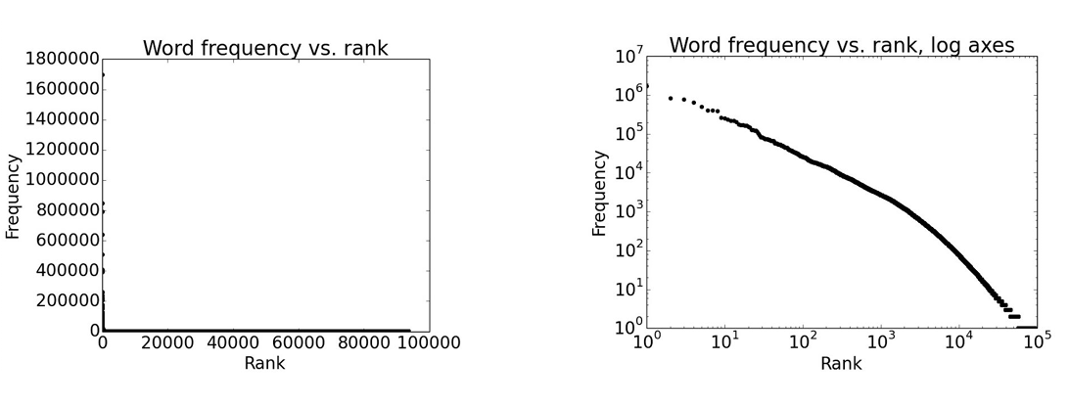
Word Frequency Distribution
Notes:
Order words by frequency. What is the frequency of nth ranked word?

Slide 49
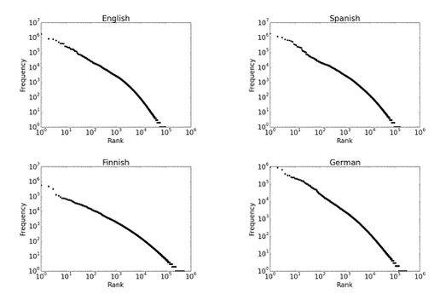
Zipf’s Law
Notes:
Regardless of how large our corpus is, there will be a lot of infrequent (and zero-frequency!) words ▪
This means we need to find clever ways to estimate probabilities for things we have rarely or never seen

Slide 50
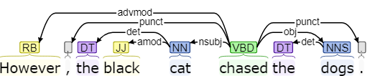
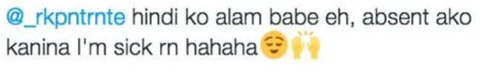
Variation over Domains
Suppose you trained a part-of-speech tagger or parser on the Wall Street Journal
What happens if you try to use the same tagger/parser for social media text?

Slide 51
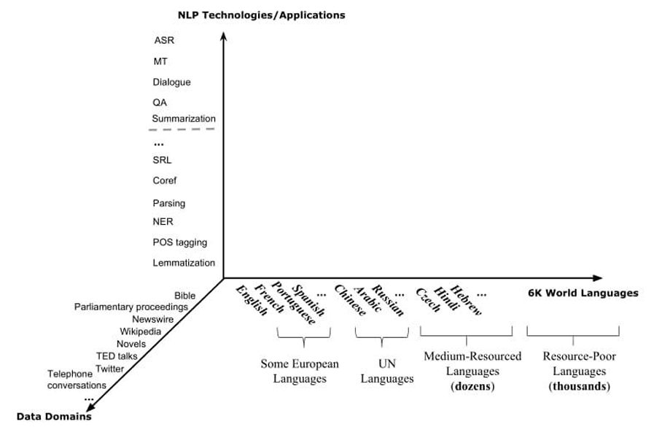
Application x Languages x Domains

Slide 52
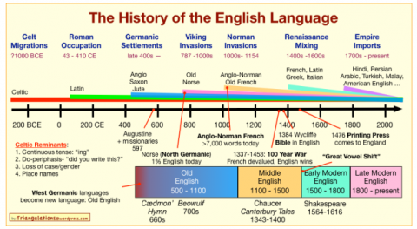
Variation over Time

Slide 53
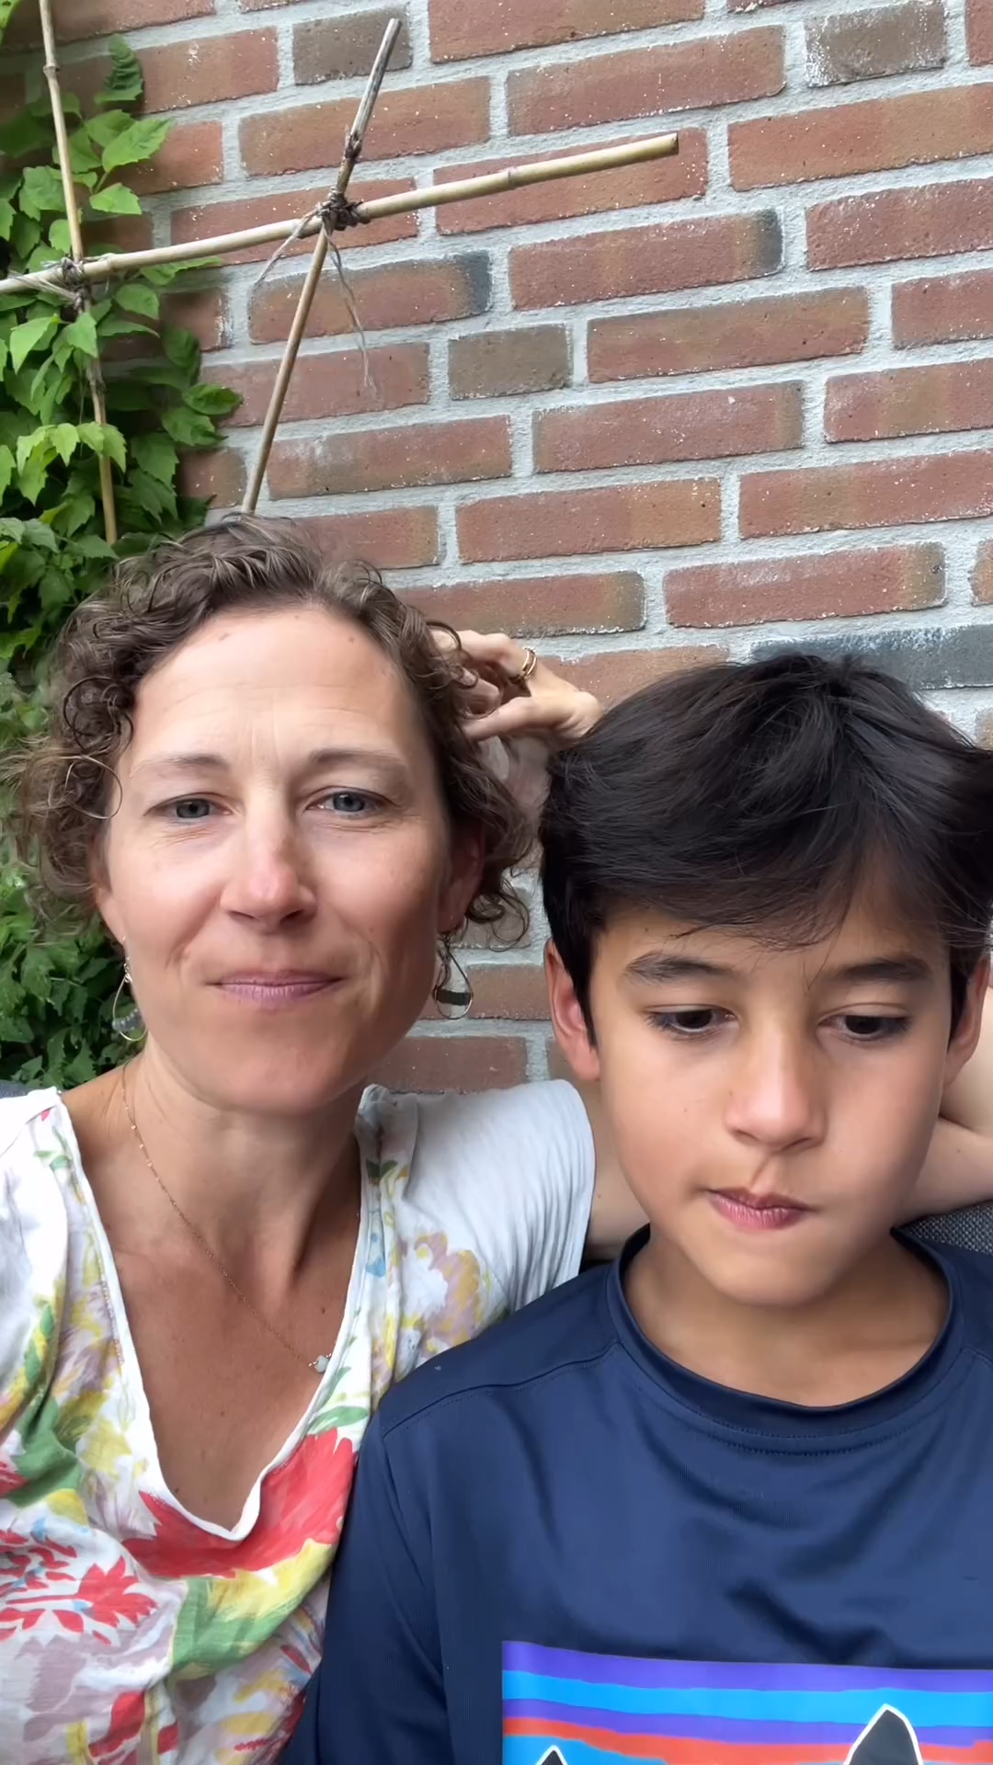
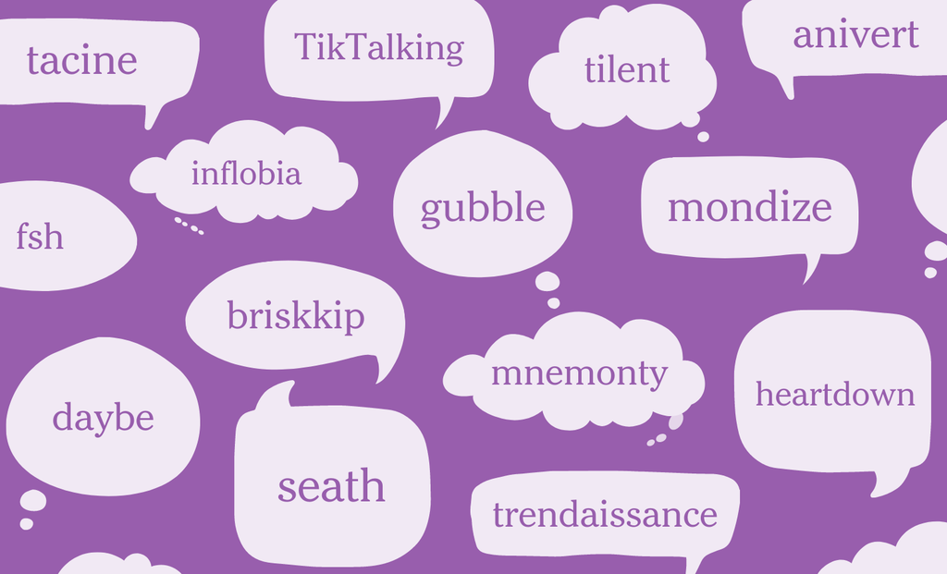
Variation over Time
24 New Words Invented by Teenagers , NYT 20220331
https://www.instagram.com/reel/C-NuNbutMD6/

Slide 54
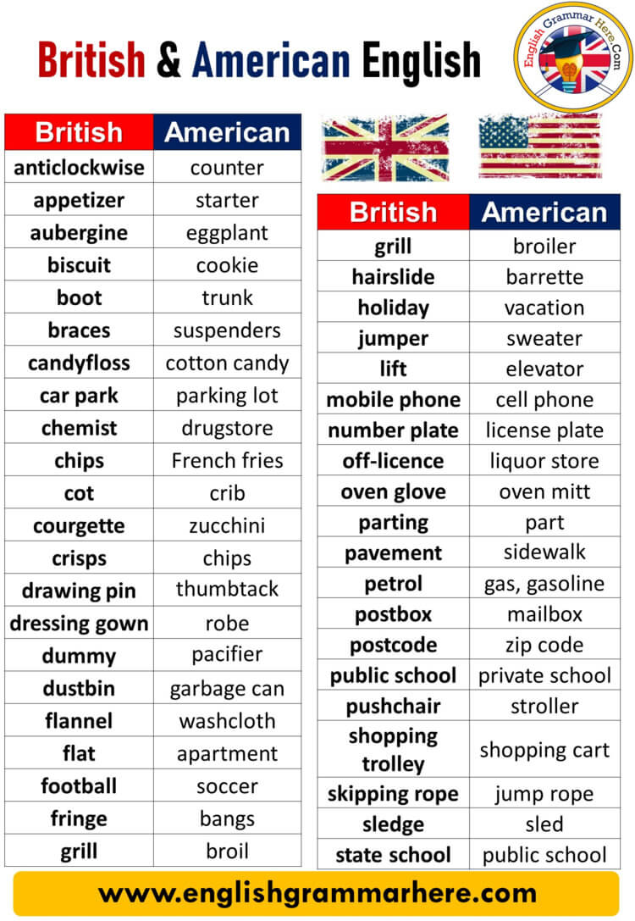
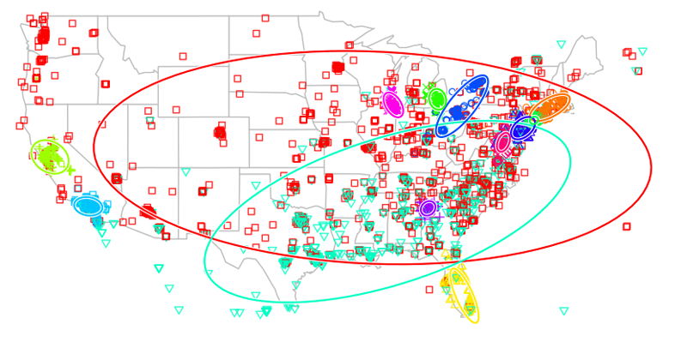
Variation over Location
A Latent Variable Model for Geographic Lexical Variation [ Eisenstein et al., 2010]

Slide 55
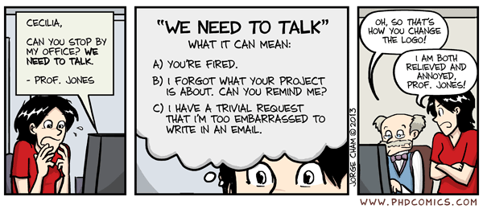
Beyond conventional meaning
Notes:
Noun / verbs /

Slide 56
Implicit meaning behind language and Pragmatics
Speech act [Austin 1962]
“Could you please pass the salt to me?”
Implicature [Grice 1975]
Alice: "Are you going to Paul’s party?"
Bob: "I have to work.“
labelling
repeating
answering
requesting (action)
requesting (answer)
calling
greeting
protesting
practicing
Notes:
“Implicature” denotes either (i) the act of meaning or implying one thing by saying something else, or (ii) the object of that act.
If this was a typical exchange, Barb meant that she is not going to Paul’s party by saying that she has to work. She did not say that she is not going to Paul’s party, and the sentence she uttered does not mean that.
s it expresses the speaker's desire to acquire the kimchi, as well as presenting a request that someone pass the kimchi to them. According to Kent Bach, "almost any speech act is really the performance of several acts at once, distinguished by different aspects of the speaker's intention: there is the act of saying something, what one does in saying it, such as requesting or promising, and how one is trying to affect one's audience
labelling
repeating
answering
requesting (action)
requesting (answer)
calling
greeting
protesting
practicing

Slide 57
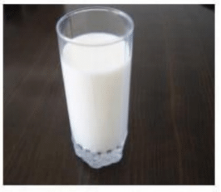

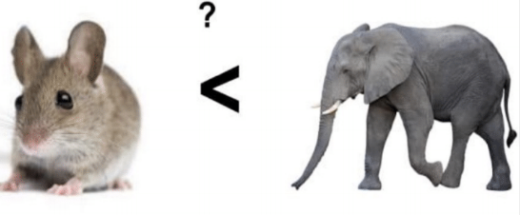
Unknown Representation
We don’t even know how to represent knowledge a human has/needs
What is the meaning of word or sentence?
How to model context or general knowledge?
“Drink this milk”
“Sunset is beautiful”
Elephants are bigger than mice?

Slide 58

Summary
NLP is interdisciplinary
Language consists of many levels of structure:
Phonology, syntax, semantics, discourse, pragmatics
Processing language is difficult, due to
ambiguity, scales, sparsity, variation, implication, and representation
Development of NLP models and representations grows rapidly
From rules to feature learning to RNNs to Transformers
“Large” language models
Generalist AI or AGI via prompting and chat
Scaling law
Multimodal
Limitations? Future directions?

Slide 59
How to process language?
Notes:
Processing is such a vague term:

Slide 60
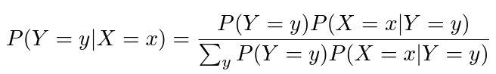
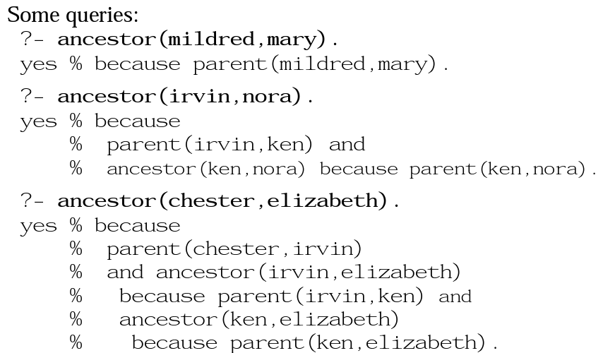
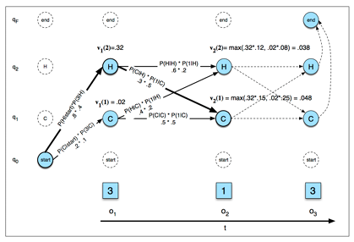
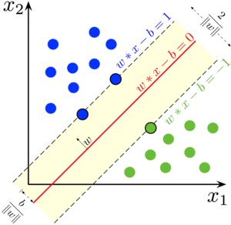
Methods
Logic-based and rule-based NLP systems (~80s)
Dynamic programming and Viterbi/CKY (~90s)
Naïve Bayes, LogReg, HMM/CRF, SVM, N-gram LMs (~00s)

Slide 61


Methods
Statistical NLP (~2005s)
Latent variable models (Early ~2010s)
Specifying probabilistic structure between variables and inferring likely latent values

Slide 62







Representations
Human-engineered features and SVMs (2005s ~ 2010s)
Learned features/representations (2013s ~ 2018)

Slide 63







Representations (Developing Attention)

Slide 64
What happened in NLP over the last five years (2019-2024)?

Slide 65


Slide 68

Scaling up!

Slide 69


Slide 70


Slide 71






The Leading Players

Slide 72

https://docs.cohere.ai/prompt-engineering-wiki/

Slide 73

https://docs.cohere.ai/prompt-engineering-wiki/

Slide 74

https://docs.cohere.ai/prompt-engineering-wiki/

Slide 75

https://docs.cohere.ai/prompt-engineering-wiki/

Slide 76

https://docs.cohere.ai/prompt-engineering-wiki/

Slide 77


Slide 78

Sentence classification via Prompting
https://towardsdatascience.com/a-quiet-shift-in-the-nlp-ecosystem-84672b8ec7af

Slide 79

Text Summarization via Prompting
https://towardsdatascience.com/a-quiet-shift-in-the-nlp-ecosystem-84672b8ec7af

Slide 80

Relation Extraction via Prompting
https://towardsdatascience.com/a-quiet-shift-in-the-nlp-ecosystem-84672b8ec7af

Slide 81

Email Generation via Prompting
https://towardsdatascience.com/a-quiet-shift-in-the-nlp-ecosystem-84672b8ec7af

Slide 82

Code Generation via Prompting
https://ai.googleblog.com/2022/04/pathways-language-model-palm-scaling-to.html

Slide 83


Mathematical Reasoning via Prompting
https://towardsdatascience.com/a-quiet-shift-in-the-nlp-ecosystem-84672b8ec7af

Slide 84

Chain-of-Thought Prompting
Few-shot CoT
Standard prompting versus chain-of-thought prompting for an example grade-school math problem. Chain-of-thought prompting decomposes the prompt for a multi-step reasoning problem into intermediate steps (highlighted in yellow), similar to how a person would approach it.
https://ai.googleblog.com/2022/04/pathways-language-model-palm-scaling-to.html

Slide 85

Chain-of-Thought Prompting
Zero-shot CoT
Large Language Models are Zero-Shot Reasoners, https://arxiv.org/abs/2205.11916

Slide 86


Slide 87

Scaling law in language model

Slide 88

https://ai.googleblog.com/2022/04/pathways-language-model-palm-scaling-to.html

Slide 89

https://ai.googleblog.com/2022/04/pathways-language-model-palm-scaling-to.html

Slide 90
https://ai.googleblog.com/2022/04/pathways-language-model-palm-scaling-to.html

Slide 91


Slide 92

Emergent behavior from Scaling Law
Jeff Dean https://ai.googleblog.com/2023/01/google-research-2022-beyond-language.html

Slide 93

Generalist NLP Agent

Slide 94




Generalist AI Agent
https://chat.openai.com/chat

Slide 95




Generalist AI Agent
https://chat.openai.com/chat

Slide 96

Web Based Agent

Slide 97


Reasoning (Test-time compute/scaling)

Slide 98

Generalist AI across different modalities
Jeff Dean https://ai.googleblog.com/2023/01/google-research-2022-beyond-language.html

Slide 99

Scaling Law in Vision-Language Model
Figure 4. The generated image for the text “A portrait photo of a kangaroo wearing an orange hoodie and blue sunglasses standing on the grass in front of the Sydney Opera House holding a sign on the chest that says Welcome Friends!”. Note the model gets the text in the image “welcome friends” correct at 20B.
https://towardsdatascience.com/a-quiet-shift-in-the-nlp-ecosystem-84672b8ec7af

Slide 100

Beyond Language

Slide 101

Limits of LLMs and the Financial Incentives of GenAI

Slide 102


Limits of scaling

Slide 103

Falling Short
Benchmarks saturate rapidly, but this does not lead to immediate capabilities on tasks we would like to automate outside the scope of those benchmarks
How much are current benchmarks serving as a proxy for getting an enormous number of intelligent people to stuff as much insight into the models as possible (either with good training environments in RL settings, or large datasets of reasoning over certain problem areas)?
How can we design better benchmarks which indicate that supposedly ‘PhD level’ models are capable of quickly doing the kinds of basic work that we actually care about

Slide 104

AI “arms race” by Big Tech
https://www.bloomberg.com/professional/insights/technology/big-tech-2025-capex-may-hit-200-billion-as-gen-ai-demand-booms/

Slide 105


Growth Economics and High CapEx
Demand-side Advantages
Supply Side Advantages

Slide 106


The Game Theory of the AI Arms Race
https://www.sequoiacap.com/article/ai-optimism-vs-ai-arms-race/

Slide 107

What if They are Wrong? (it will sting, but they will probably be fine…unless margin increases)
Computer hardware depreciates very rapidly (typically ~50% every 2-3 years)
This means revenues must be recovered from high spend very fast in order to compensate for this loss

Slide 108
Summary
NLP is interdisciplinary
Language consists of many levels of structure:
Phonology, syntax, semantics, discourse, pragmatics
Processing language is difficult, due to
ambiguity, scales, sparsity, variation, implication, and representation
Development of NLP models and representations grows rapidly
From rules to feature learning to RNNs to Transformers
“Large” language models
Generalist AI or AGI via prompting and chat
Scaling law
Multimodal
Limitations? Future directions?

